Slide 1
Engineering for Particle Accelerators
- Magnets
Homework

Slide 2
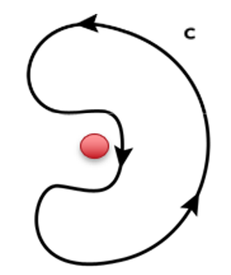
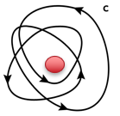
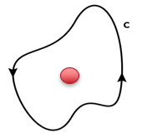
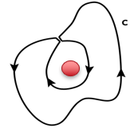
Homework 1
Calculate the magnetic filed integral along the following paths.
Current I
(e) Loop of N turns enclosing wire
(c) Path which does not
Enclose the wire
Crooked path
enclosing wire
Circular and crooked path NOT enclosing wire

Slide 3
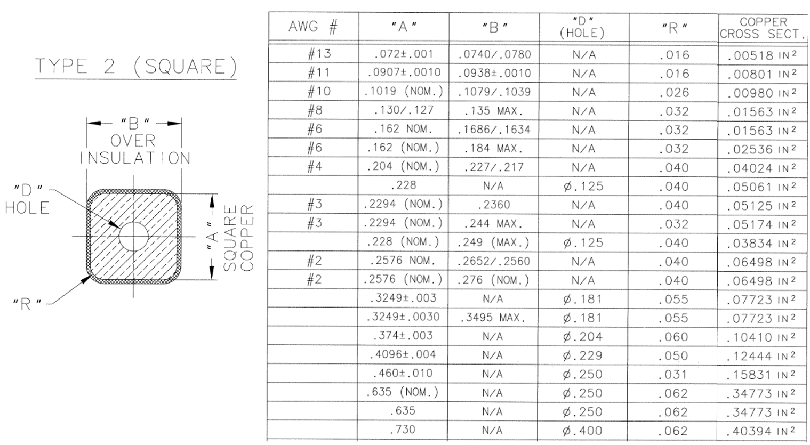
Homework 2
A C-shape dipole is needed to provide 0.5 T magnetic flux density at the center of the 50 mm air gap. Calculate the ampere-turns requires for the coil. Select the proper conductor from the table below and calculate the number of turns. The power supply can provide a maximum current of 500 A. Note that the current density for water cooled magnets is less than 4.0 A/mm².

Slide 4
Homework 3
The specification of the H-shape dipole corrector for LBNF beamline is listed.
Determine the number of turns for the coil.
Select the conductor size and calculate the current density.
Design the coils, number of layers and turns/layer, given the conductor insulation thickness 0.36 mm.
Estimate the pole width b for the core.
Calculate the magnetic field in the core.
Hint:
Pole effective length L_{p} = L_{m} + g/2.
Find the proper square-shape conductor size using the table below.
RMS current is 50% of the maximum AC current (same power dissipation, which is 15 A.
Property | SI Units
Pole gap | 76.2 mm
Integrated field strength | 0.15 T-m
Maximum AC current | 30 A
Field Homogeneity in 2”x2” good field area | <0.75%
Core length | 0.305 m
Max. Cross-section | 24”x24”
Cooling | Air cooled
Color | Yellow

